Slide 1
System and Network Administration
Security Policies
& Host Security

Slide 2
Secure Systems
1. Security policy
What needs to be protected
Kinds / level of protection
Responsibilities
Auditing policy
3. Security mechanisms
cryptography
authentication
security protocols
2. Security environment
Physical environment
Physical security
Hardware, operating system
firewalls, etc
4. Monitoring and auditing procedures
monitor access
audit trails
feedback on failures, security breaches
containment & recovery

Slide 3
A Philosophy
System Administration is about
Putting together a network of computers
Getting them to run some applications
Keeping them running in a dynamic world
System Administration is as much about technology as it is about user behaviour
System Administration requires constant monitoring and rapid response to problems

Slide 4
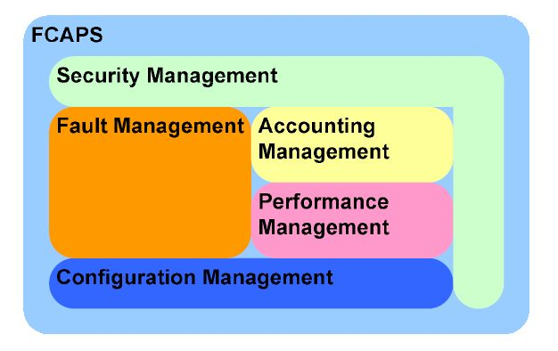
The OSI Network Management Model
Aimed at standardizing management systems – not necessarily at standardizing manager behavior
Network Configuration Management
10 Sep 2007 - https://www.cisco.com/en/US/technologies/tk869/tk769/technologies_white_paper0900aecd806c0d88.html

Slide 5
FCAPS: Fault Management
Detect faults, or abnormal operation of network
Isolate (the cause of the) fault, and
Correct the problem, in order to return to a normal/functional state

Slide 6
FCAPS: Configuration Management
Network structure
design or functional requirements, geography or building requirements, network engineering constraints
Network architecture
Network segmentation, addressing
Name resolution, Directories
Start-up of services and software
Network policy
User rights and responsibilities
Application limits and responsibilities
Security and privacy

Slide 7
FCAPS: Accounting Management
Establish how to charge users for the utilization of managed objects or resources on the network,
Establish auditing of utilization for purposes of intrusion detection.

Slide 8
FCAPS: Performance Management
Monitor and evaluate the behaviour of managed objects
Evaluate the effectiveness of communication activities
Evaluate if performance targets are being met, e.g., speed, efficiency, maximizing bandwidth or channel capacity, minimization of data loss during communications, avoidance or resolution of traffic congestion, throughput.

Slide 9
FCAPS: Security Management
Implement security policies
Protect managed objects from misuse, sabotage, unauthorized access
Ensuring data integrity
Analysing security state of network
Administering firewalls, web security, VPN (virtual private networks)
Intrusion detection

Slide 10




Slide 11
Policy Based Network Management
from policy to implementation, e.g., for configuration management
Policy = A clear expression of goals and responses
Prepares for possible errors or problems
Documents Intent and Procedure
Necessary in medium to large organisations or where many administrators co-operate
Helps to align system operation with organisational objectives

Slide 12
Security Management
The security policy defines what information is to be protected and from whom
Security policy applies to resources under control of the enterprise
Security mechanisms implement aspects of the security policy, and their effectiveness must be monitored

Slide 13
Security Policy
Strict control over access to system configuration files
Control privileges
Users should only have access to the services that they have been specifically authorised to use and any access by remote users or connections to remote computer systems must be authenticated.
Encrypted communication channels
Close telnet and ftp ports – use ssh
Monitor system use and performance
Track reports of attacks and vulnerabilities
Test and evaluate failure modes
Avoid single point of failure

Slide 14
Security Management
Security policy applies to resources under control of the enterprise; acceptable use policy applies to people and interfaces.
Security procedures implement aspects of the acceptable use policy, and compliance must be monitored

Slide 15
Acceptable Use Policy
Should include at least:
An access policy - defines access rights and privileges
An accountability policy - defines the responsibilities of users, operating staff, and management
An authentication policy - establishes trust via something the user knows, has, or is
A privacy policy - defines reasonable expectation of monitoring of email, access to user files, etc
A technology policy - guidelines for purchasing, configuring, and auditing computer systems

Slide 16
Acceptable Use Policy
Acceptable use policy should specify
Applications that are run on networks PCs and restrict the downloading of unknown application from internet or other sites.
Users connect only permitted computers or other devices to the LAN interfaces in their offices.
“BYOD” (Bring Your Own Device) needs to be dealt with
e.g.,** wireless@apu v, Staff@apu
Encourage users to log out their session when not in use.
Security Policy needs to include steps to minimise social issues
user education
clearly stated policy on disclosing information over the phone

Slide 17
Security Policy
The implications are:
implementing the acceptable use policy is essentially a management issue;
implementing the security policy is more of a technical issue;
security policy implementation mechanisms must provide information necessary for enforcement of the acceptable use policy.
Monitoring effectiveness of mechanisms and compliance with policies (accountability) requires keeping track of activity (audit trails)

Slide 18
RedHat 9 Security Guide
p.46 securing portmap
p.49 securing nfs
p.50 securing web
p.54 sendmail (a postfix alternative)
p.55 nmap
p.65, 75-77, 97- firewalls

Slide 20
Network Policy
Segmentation
Subnet addressing
Logical to physical address mapping (VLANs?)
Port Blocking? Different on each subnet?
Blocking at Firewall or Router?
Address configuration
Static /etc/hosts, DHCP
Name Resolution
DNS, WINS
Directory Services
Notes:
Virtual LAN
From Wikipedia, the free encyclopedia
A virtual LAN is built top of an existing physical network. Several VLANs can co-exist on such a network. This makes it convenient to organize hosts into VLANs while, in reality, they may be on the same physical LAN or on separate ones. VLANs are meant to be independent of one another, hence they are not meant to share information across other VLANs. A host on a VLAN may physically move across to other actual networks but remain part of the same VLAN. Support for this virtual connectivity may be via software, although some devices such as switches and routers may support VLANs by default.
A directory service defines the namespace for a given network, providing a a shared information infrastructure that allows organizations to store, find, manage and organize common items and network resources. This includes volumes, folders, files, printers and other devices, users and information about them, groups, etc. A namespace usually organizes data hierarchically, which might reflect the real world hierarchy of departments within organizations, networks within departments, and hosts within networks. Several standards such as LDAP would identify a namespace object by distinguished name (DN), and associates such objects with a collection of attributes to describe the object.

Slide 21
Applications Policy
SMTP
Name aliases (eg Chris.Freeman@monash.edu.au)
File size and type limitations for attachments
SPAM filtering
Virus checking
HTTP
Content & Style guides, plagiarism, authorisation?
CGI / Modules allowed? (eg Apache mod_perl, mod_ssl)
Load Limiting

Slide 22
Resource Sharing Policy
File Systems
Common/Shared directories? Read-only?
Backups
Global or Local?
Image or File?
Archival or Incremental?
Printing
Personal printing? Page count quotas?
Colour vs Monochrome

Slide 23
User Account Policy
formal user registration and deregistration procedure for granting access
allocation of passwords controlled through a formal management process.
a formal process conducted at regular intervals to review users’ access rights.
policies and procedures governing use of mobile computing and teleworking facilities.
Password Issues
No passwords
Easily guessed
Password aging
Login shells
Access to encrypted passwords
Group logins – Shared accounts
Root privileges

Slide 24
Non-Technical aspects of Security
Otherwise impenetrable systems can still be compromised using “Social Engineering”.
An unwary user may be tricked into revealing the keys to sensitive information ( “Phishing” )
Phone call from bogus SysAdmin who needs info to repair or install
Bogus Market survey with questions that reveal enough info to be able to guess passwords or key information
Discarded documents with account numbers or other pertinent data
Notes:
FIT2018 Network Admin: Principles of Security
3/12/2020
FIT2018 (c) Monash University
24

Slide 25
Non-Technical aspects of Security
Bragging
Misguided users bragging about how good their system is, are actually giving information away.
Egotistical crackers may over emphasize their success to provoke a situation where more information is revealed.
Security Policy needs to include steps to minimise these social issues
user education
clearly stated policy on disclosing information over the phone
Check Lists
Notes:
FIT2018 Network Admin: Principles of Security
3/12/2020
FIT2018 (c) Monash University
25

Slide 26
Password Security
Passwords
Consistent use of Strong Passwords
UP, low, Num, # - _ + ~
Prevent brute force and dictionary attacks
Force users to change their password
Set an expiration date
Be sure to send plenty of warnings
Expect complaints!
Combat Password Sniffing
telnet, ftp etc use plaintext passwords that are visible to protocol analysers
Use SSH/SSL
Try out
pwgen
What are the likely consequences?
(simple, written down)
Notes:
26
Passwords:
After prevention and recovery from accidents, consistent use of strong passwords is next most important in network security. Schemes that bypass direct password security (eg .rlogin and .rhosts etc.) can severely undermine host and network security, because they trust DNS lookups for trusted hosts to permit unguarded logins, and one in, a cracker could gain access to other systems with similar trust relationships. Password Formation Rules are often used to enforce the use of strong passwords. Password Aging is often used to force password replacement. But although passwords are not stored in plain text, the encrypted form is often visible. Tools like Alec Muffet’s crack can be used to find weak passwords before the crackers do.
Password Sniffing
Many old protocols exchange passwords in plain text on the wire (Telnet, FTP) and a cracker with privileged access to a workstation can run a protocol analyser to capture packets and display passwords therein. Switched Networks make this harder. SSH and SSL services can completely encrypt user data. One-Time Passwords or pattern presentation passwords also solve this problem.
Network Services Do we really need this service? The list of services with known holes increases daily! If you don’t really need it, don’t run it.

Slide 28
RedHat 9 Security Guide
8. Vulnerability Assessment
8.1. Thinking Like the Enemy
8.2. Defining Assessment and Testing
8.3. Evaluating the Tools
10. Incident Response
10.1. Defining Incident Response
10.2. Creating an Incident Response Plan
10.3. Implementing the Incident Response Plan
10.4. Investigating the Incident
10.5. Restoring and Recovering Resources
10.6. Reporting the Incident
Appendix A. Common Exploits and Attacks

Slide 29
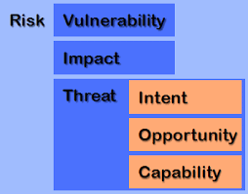
Intruder prevention
White hat hackers (penetration testing)
Scanning
Vulnerability analysis
System update/patch

Slide 30
Threat Model
A threat model helps in analyzing a security problem, design mitigation strategies, and evaluate solutions
Steps:
Identify attackers, assets, threats and other components
Rank the threats
Choose mitigation strategies
Build solutions based on the strategies

Slide 31
Intrusion Lifecycle
Phase | Technique | Description
 | Reconnaissance | Gather as much info about targets as possible. Required to craft an attack.
 | Initial exploitation | Gain access to network or hosts, obtain credentials, etc.
 | Privilege escalation | Gain greater control over systems. Can do more damage with higher privileges.
 | Pivoting | Compromise a central host. Spread to other hosts and network segments.
 | Persistence | Maintaining access is an important goal. Avoiding discovery, erasing traces of activity
1
2
3
4
5

Slide 32
https://attack.mitre.org/#
The MITRE Corporation, a not-for-profit org, released the ATT&CK Framework in 2015, for the private sector, governments, the cybersecurity product and service community, and the general public.
ATT&CK stands for Adversarial Tactics, Techniques, and Common Knowledge. The framework is a matrix of intrusion techniques.
The ATT&CK Framework is essentially the attacker’s playbook — how they get in your system, how they move, what they do, what their end goals are, and how it impacts your system. ATT&CK maps and indexes virtually everything regarding an intrusion from both the attack and defense sides.

Slide 33
MITRE ATT&CK Framework
The ATT&CK Matrix is composed of tactics, techniques, and procedures, otherwise known as TTP. Following the columns, or tactics, from left to right, shows steps an attacker would typically follow when attacking your organization.
Multiple techniques can be employed to accomplish the same tactic, and depending on the attacker’s main objective, not all 12 tactics need to be employed.
The aggregate of techniques used during an attack is known as the behavior profile — the procedure the attacker followed to accomplish their ultimate goal by attacking your system.
Each of the 220+ techniques on the ATT&CK matrix has a page that includes a brief summary of the adversarial technique, procedure examples, mitigations for detecting and defending against each of these attacks.

Slide 34
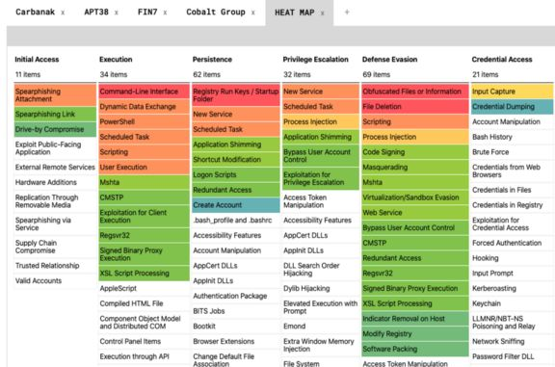

Slide 35
https://attack.mitre.org/matrices/enterprise/#
Initial Access — techniques that use various entry vectors to gain an initial foothold within a network (e.g., T1192 Spearphishing Link)
Execution — techniques that result in running attacker-controlled code on a local or remote system (e.g., T1086 PowerShell)
Persistence — techniques used to maintain persistent access to a system (e.g., T1037 Logon Scripts)
Privilege Escalation — techniques used to gain higher-level privileges on a system or network (e.g., T1055 Process Injection)
Defense Evasion — techniques used to avoid detection (e.g., T1073 DLL Side-Loading)
Credential Access — techniques for stealing credentials such as account names and passwords (e.g., T1208 Kerberoasting)

Slide 36
https://attack.mitre.org/matrices/enterprise/#
Discovery — techniques used to gain knowledge about the system and internal network (e.g., T1040 Network Sniffing)
Lateral Movement — techniques used to enter and control remote systems on a network from the already compromised host (e.g., T1097 Pass the Ticket) Attackers typically have to pivot through multiple machines (usually the weakest link in the chain of machines) to ultimately reach their end objective.
Collection — techniques used to gather information relevant to following through on the attacker’s objectives (e.g., T1056 Input Capture)
Command & Control — techniques attackers may use to communicate with systems under their control, often disguised to look like normal HTTP traffic (e.g., T1172 Domain Fronting)
Exfiltration — techniques used to steal data from your network (e.g., T1002 Data Compressed)

Slide 38
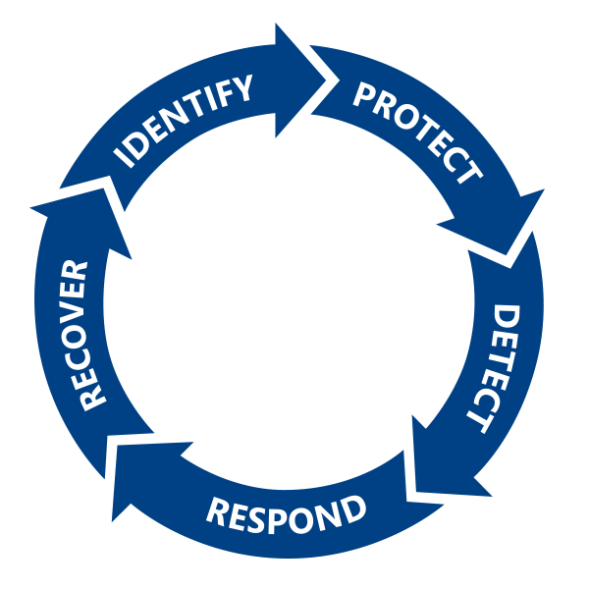
NIST Cybersecurity Framework
Identify high-value assets
Protect against known and unknown threats
Detect attacks
Respond to suspicious activity
Recover from breach
A cycle of Continuous Improvement

Slide 39
Vulnerability Assessment
A vulnerability assessment is an internal audit of your network and system security
If you were to perform a vulnerability assessment of your home, you would check each door to see if they are shut and locked, and check every window, making sure that they shut completely and latch correctly.
This same concept applies to systems, networks, and electronic data. Malicious users are the thieves and vandals of your data. Focus on their tools, mentality, and motivations, and you can then react swiftly to their actions.

Slide 40
Network Scanners and Analysis Tools
Network Tool | Description
Packet analyzer | Monitors wireless or wired network communications. Captures traffic data. Can be used to gather information by examining packet contents.
Protocol analyzer | Uses data captured by packet analyzer. Identifies protocols and applications used by traffic. Can reveal malicious traffic using specific vectors.
Network enumerator | Identifies logical topology of a network to reveal connection pathways. Provides high-level overview of network architecture.

Slide 41
Port Scanning Attacks
Port: An endpoint of a logical connection that host computers use to connect to processes or services on other hosts.
Port scanning attack: A network-based attack where an attacker scans computers and other devices to see which ports are listening, in an attempt to find a way to gain unauthorized access.
TCP and UDP ports scanned.
Active services scanned.
Can be automated.
Likely to occur, whether you’re aware of it or not.

Slide 42
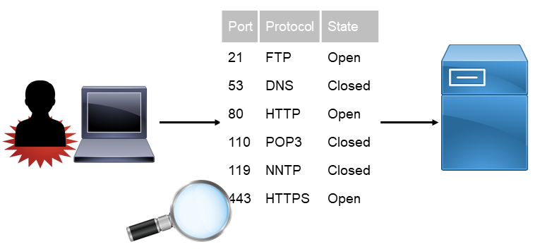
Port Scanning Attacks (Cont.)

Slide 43
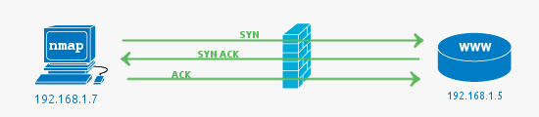
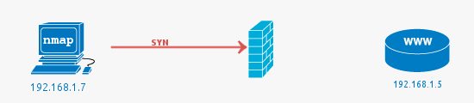
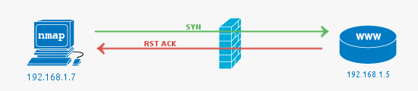
https://hackertarget.com/nmap-tutorial/
open
filtered
closed

Slide 44
nmap
nmap ("Network Mapper") is a utility for network discovery and security auditing.
It uses raw IP packets in novel ways to determine what hosts are available on the network, what services (application name and version) those hosts are offering, what operating systems (and OS versions) they are running, what type of packet filters/firewalls are in use, and dozens of other characteristics.

Slide 45
Port scanning: hping
The standard hping behaviors are encapsulated into a scanning algorithm.
for example to perform a SYN scan you just specify the -S option
you can change the TCP windows size, TTL, control the IP fragmentation as usual, and so on.
Unlike most scanners, hping shows some interesting info about received packets, the IP ID, TCP win, TTL, and so on,
Don't forget to look at this additional information when you perform a scan! Sometimes they reveal interesting details.

Slide 47
Vulnerability Assessment Tools
Tool Type | Implement To
Vulnerability scanner | Assess systems, networks, and apps for weaknesses.
Port scanner | Assess current state of all ports on a network.
Protocol analyzer /packet sniffer | Assess traffic and what it reveals about contents and protocols being used.
Fingerprinting tools | Identify a target's OS information and running services.
Network enumerator | Map logical structure of network and identify rogue systems.
Password cracker | Recover secret passwords from stored or transmitted data.
Backup utilities | Create copies of scanned data.

Slide 48
Checklist
List of Hosts
List of type and versions of OS used
List of services provided
List of patches applied & non-standard software
Test for weak passwords (crack, satan, john the ripper)*
Ensure latest security patches are applied
Evaluate trust relationships between hosts
Monitor processes: watch for unusual or excessive process spawning
Check file system for suspicious files
Use a port scanner to find vulnerabilities*
* Try it first – before someone tries it on you
Notes:
48
Trust Relationships are v.difficult to disentangle. They are an “Implied Dependency”. Complexity of trust relationships between host services is usually hidden and not immediately obvious! This especially applies to NFS mounts. Eg. The root user on a machine allowed to mount remote files systems has total access and may be able to access private user data located there.
rlogin, rsh, rexec etc.. All rely on trust relations which allow nominated users and hosts (those found in .rhosts and hosts.equiv) to login directly

Slide 49
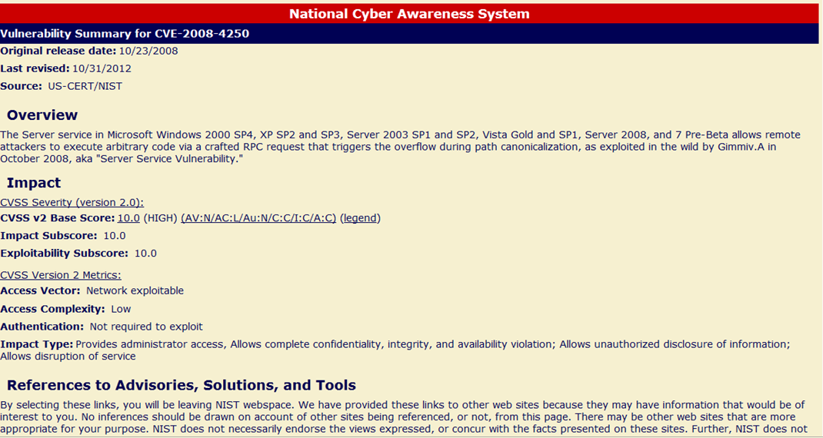
Vulnerability Tracking
Common Vulnerability & Exposures (CVE)
Sample: CVE-2008-4250

Slide 51
Attack!
Don’t panic
Determine the appropriate level of response
Gather tracking information
Assess degree of exposure
Pull the plug
Devise recovery plan
Communicate the recovery plan
Implement the recovery plan
Report the incident
Security Specialists
Plan
Lead
Follow up
System Administrators
Participate
Implement
Execute
Vulnerability Assessment
Incident Response

Slide 52
Incident Response
How will you respond to Incidents of misuse (malicious or abusive activity inside the network) or intrusion (breaches from the outside) ?
The incident response plan needs to cover four key activities:
Immediate action
Investigation
Restoration of resources
Reporting the incident to proper channels

Slide 53
Incident Response
An incident response must be decisive and executed quickly.
Reacting quickly may minimize the impact of resource unavailability and the potential damage caused by system compromise.
There is little room for error in most cases.
By staging practice emergencies and measuring response times, it is possible to develop a methodology that fosters speed and accuracy.
This is often referred to as “white-hat” or “ethical” hacking

Slide 54
Incident Response
The incident response plan needs input from legal counsel, to alert technical and managerial staff to the legal ramifications of breaches
the hazards of leaking a client's personal, medical, or financial records for example, and the importance of restoring service in mission-critical environments such as hospitals and banks.
Can a person be fired if their weak password caused the disclosure of credit card numbers in our database of ecommerce customers?
Or should the system administrator who allowed the user to have a weak password be fired?

